Slide 1
Chapter 17
Theory
of
Computation

Slide 2
OBJECTIVES
After reading this chapter, the reader should
be able to:
Understand how a simple language with limited statements can
solve any problem.
Understand how the Turing machine can solve any problem that
can be solved by a computer.
Understand the Godel number and its importance in the
theory of computation.
Understand the halting problem as an example of a large
set of problems that cannot be solved by a computer.

Slide 3
17.1
SIMPLE
LANGUAGE

Slide 4
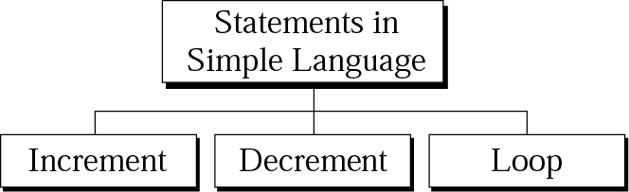
Figure 17-1
Statements in simple language

Slide 5
17.2
TURING
MACHINE

Slide 6
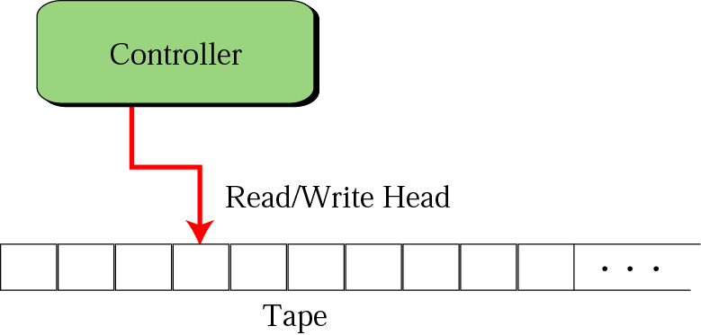
Figure 17-2
Turing machine

Slide 7
Figure 17-3
Tape

Slide 8
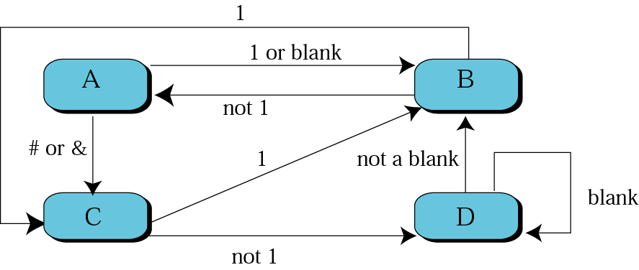
Figure 17-4
Transition state

Slide 9
Table 17.1 Transitional table
Current
State
-----
A
A
B
B
C
C
D
D
Read
-------------
1 or blank
# or &
1
not 1
1
not 1
not a blank
blank
Write
----------------
#
&
1
same as read
blank
1
same as read
1
Move
--------
➔
⬅
⬅
➔
➔
➔
⬅
New
State
-----
B
C
C
A
B
D
B
D

Slide 10
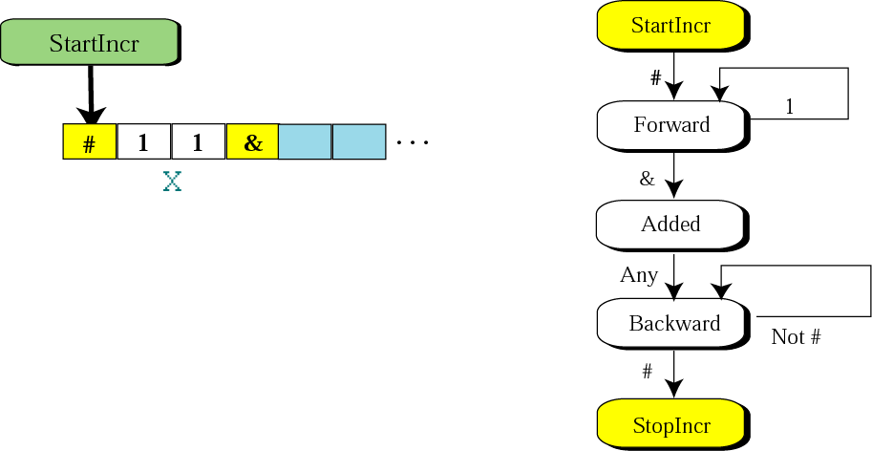
Figure 17-5
Transition diagram for incr x

Slide 11
Table 17.2 Transitional table for incr x statement
Current
State
---------
StartIncr
Forward
Forward
Added
Backward
Backward
Read
-------------
#
1
&
any
not #
#
Write
----------------
#
1
1
&
same as read
#
Move
--------
➔
➔
➔
⬅
⬅
New
State
----------
Forward
Forward
Added
Backward
Backward
StopIncr

Slide 12
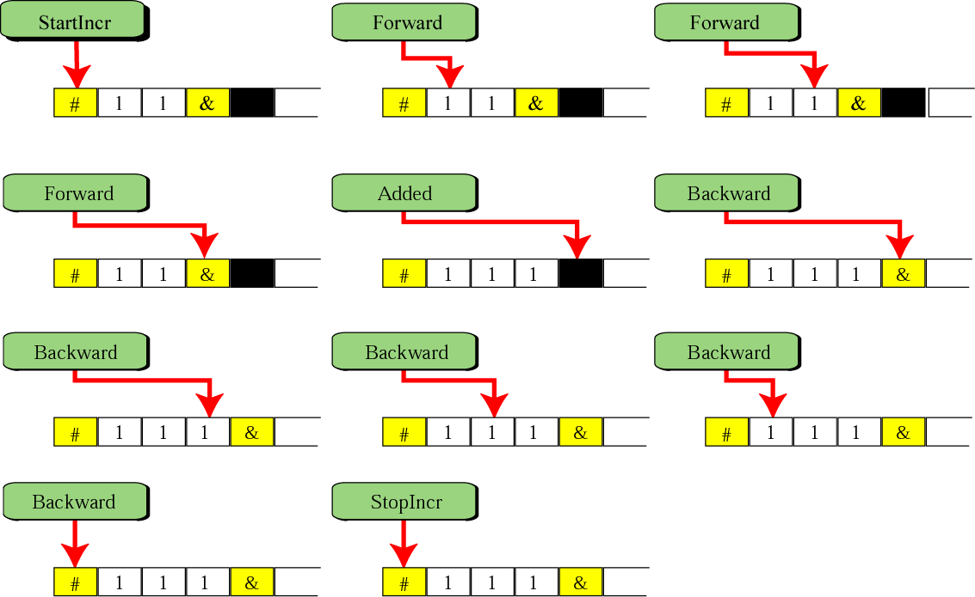
Figure 17-6
Steps in incr x statement

Slide 13
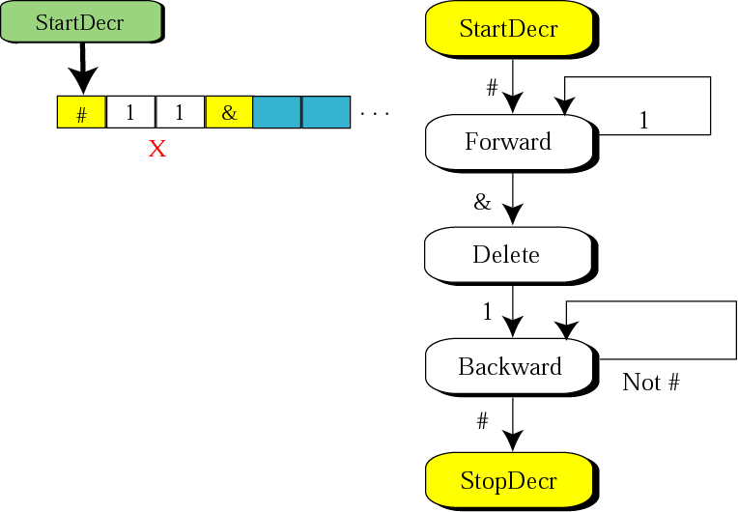
Figure 17-7
Transition diagram for decr x

Slide 14
Table 17.3 Transitional table for decr x statement
Current
State
---------
StartDecr
Forward
Forward
Delete
Backward
Backward
Read
-------------
#
1
&
1
not #
#
Write
----------------
#
1
blank
&
same as read
#
Move
--------
➔
➔
⬅
⬅
⬅
New
State
----------
Forward
Forward
Delete
Backward
Backward
StopDecr

Slide 15
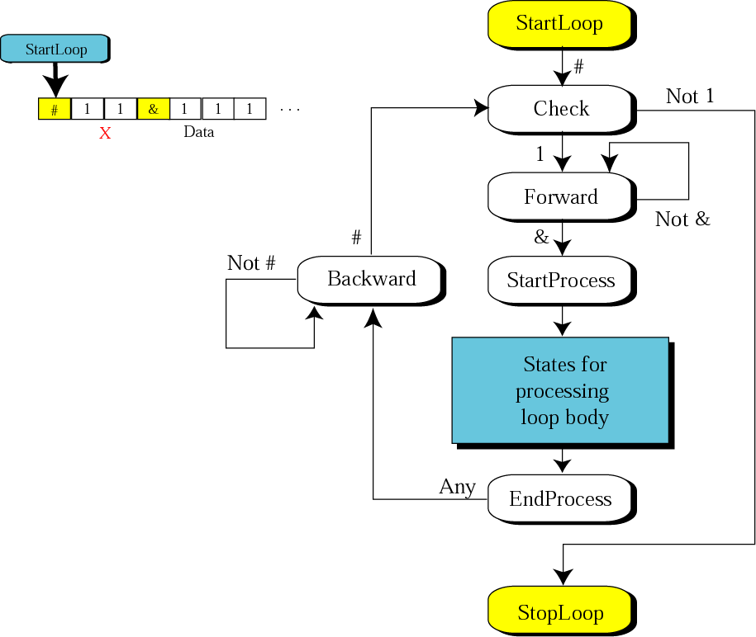
Figure 17-8
Transition diagram
for the loop statement

Slide 16
Table 17.4 Transitional table for the loop statement
Current
State
---------
StartLoop
Check
Check
Forward
Forward
…
…
EndProcess
Backward
Backward
Read
-------------
#
not 1
1
not &
&
…
…
any
not #
#
Write
-------------
#
same as read
1
same as read
&
…
…
same as read
same as read
#
Move
--------
➔
⬅
➔
➔
none
…
…
⬅
⬅
none
New
State
---------
Check
StopLoop
Forward
Forward
StartProcess
…
…
Backward
Backward
Check

Slide 17
17.2
GODEL
NUMBERS

Slide 18
Table 17.5 Code for symbols used in the
Simple Language
Hex Code
-------------
1
2
3
4
5
6
7
8
Symbol
---------
1
2
3
4
5
6
7
8
Hex Code
-------------
1
2
3
4
5
6
7
8
Symbol
---------
9
incr
decr
while
{
}
x
Hex Code
-------------
9
A
B
C
D
E
F

Slide 19
17.3
HALTING
PROBLEM

Slide 20
A Classical
Programming Question:
Can you write a program that tests
whether or not any program, represented by its Godel number,
will terminate?

Slide 21
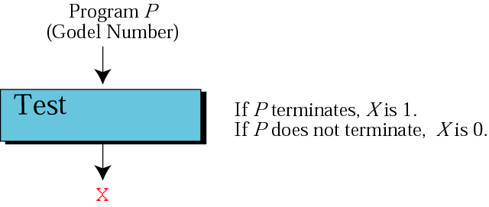
Figure 17-9
Step 1 in proof

Slide 22
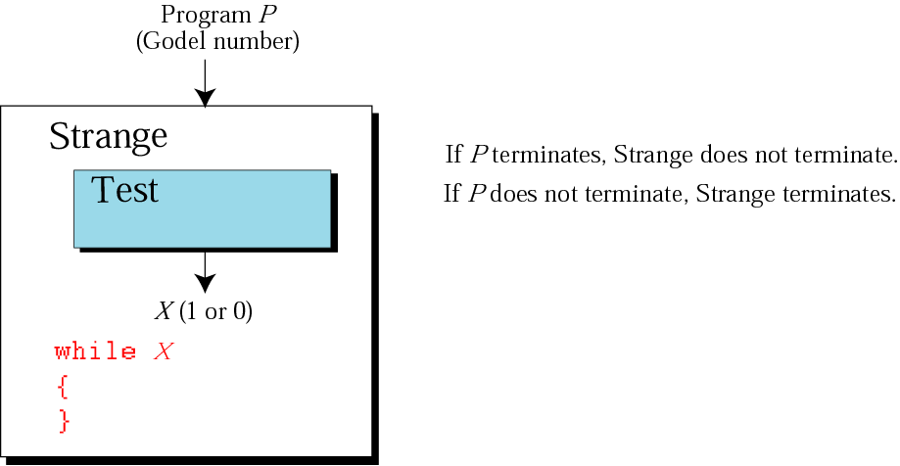
Figure 17-10
Step 2 in proof

Slide 23
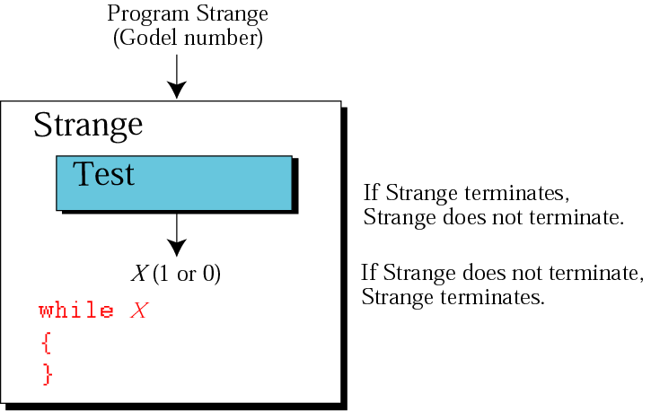
Figure 17-11
Step 3 in proof

Slide 24
17.5
SOLVABLE AND
UNSOLVABLE PROBLEMS

Slide 25
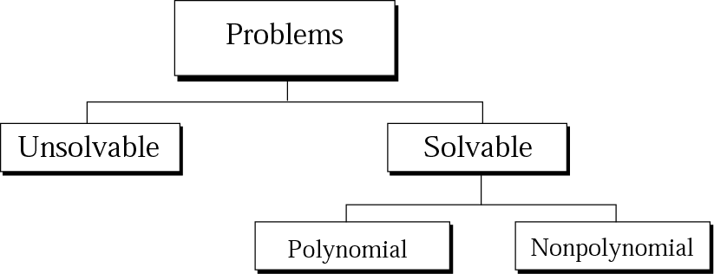
Figure 17-12
Taxonomy of problems

